Slide 1
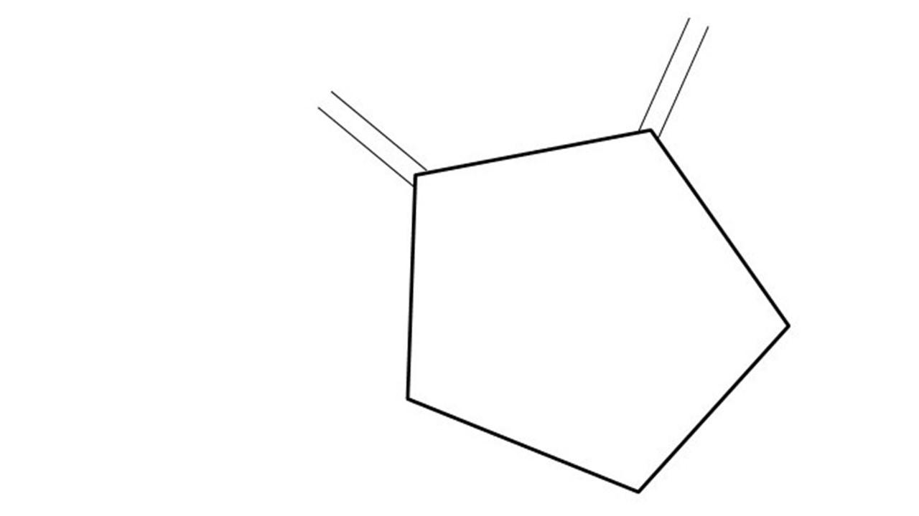
Great Cow BASIC Release Candidate 39
PIC-AS Capability
Feb 2021

Slide 2
Overview
Great Cow BASIC supports
PIC-AS XC8 tool chain
Pickit 4 programmers
Installation and configuration

Slide 3
PIC-AS
Microchip Technology recently released a new assembler for their PIC and AVR microcontroller devices.
The new compiler called the MPLAB XC8 PIC Assembler, is meant to replace the now decades old MPASM assembler.
Commonly called PIC-AS

Slide 4
PIC-AS
Why does Great Cow BASIC need PIC-AS support
Teaching aid
Debugging
Support from Microchip
MPASMx is not supported by new chips

Slide 5
Great Cow BASIC Compiler
Great Cow BASIC is an Open Source compiler for PIC, AVR and LGT microcontrollers
Great Cow BASIC now supports the PIC-AS compiler
Great Cow BASIC is a cross platform with common code translation
Great Cow BASIC Compiler

Slide 6
The core compiler
High Level Language
Reports:
TXT and HTML
Source Code
Great Cow BASIC Compiler
Great Cow BASIC Compiler
Preprocessor
Code Translator
Assembler
Linker
Assembly Language
ASM file
Absolute Machine Code
HEX file
Libraries
8 bit PIC and AVR

Slide 7
Using PIC-AS
High Level Language
Reports:
TXT and HTML
Source Code
PIC-AS,
MPLABX-IDE
Great Cow BASIC Compiler
Great Cow BASIC Compiler
Preprocessor
Code Translator
Assembler
Linker
Assembly Language
file
Absolute Machine Code
HEX file
Libraries
8 bit PIC and AVR

Slide 8
Installation
Backup old installation
BACKUP YOUR USE.INI
Rename D:\GCB@Syn38\GreatCowBasic\USE.INI to USE.OLD
Complete the installation of release
Failure to rename/replace USE.INI will stop generation of a HEX file

Slide 9
Installation
Walk thru of installation

Slide 10
Configuration for PIC-AS
Install XC8/PIC-AS compiler
GOOGLE: microchip xc8 download
https://www.microchip.com/en-us/development-tools-tools-and-software/mplab-xc-compilers#Downloads%20and%20Documentation%20
Walk thru of updating USE.INI
Validate PIC-AS installation directory
Enable PIC-AS
Create a MPLAB-X project and walk the debugger
Google: microchip MPLABX

Slide 12
Great Cow BASIC & MPLAB-X/PIC-AS
Install MPLAB-X
Create a project

Slide 13
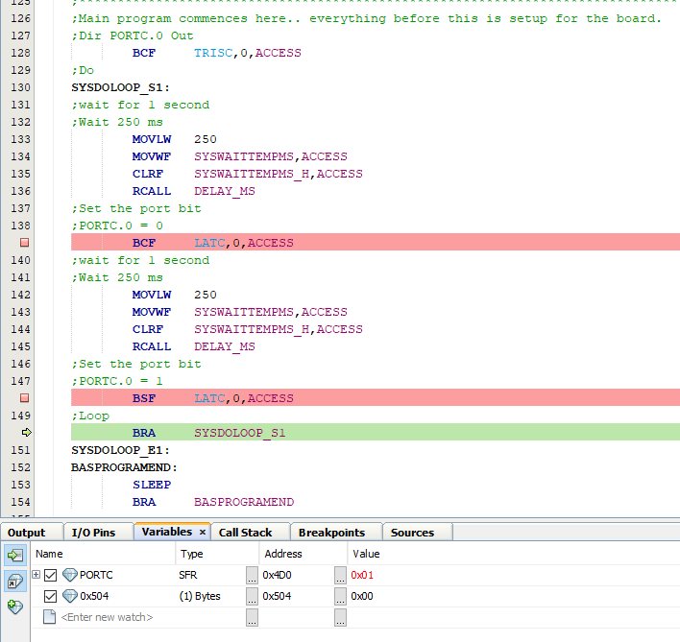
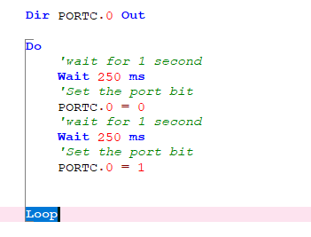
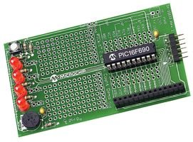

Great Cow BASIC & MPLAB-X/PIC-AS

Slide 14
Great Cow BASIC
Great Cow BASIC for the PIC18FxxQ41 chip Family
January 2021

